Slide 1
Clustering Objects Based on their Interaction
Presentation By -
Himanshu Verma
Akshat Tiwari

Slide 2
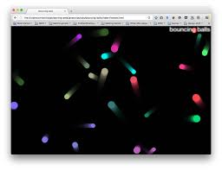
Problem Statement
Given a short video clip of physical objects moving under each other’s influence, group the objects on the basis of type of interactions between them.

Slide 3
Work in this Direction
Visual Interaction Network(VIN) : Attempt to generate future states by on training on initial part of a video.

Slide 4
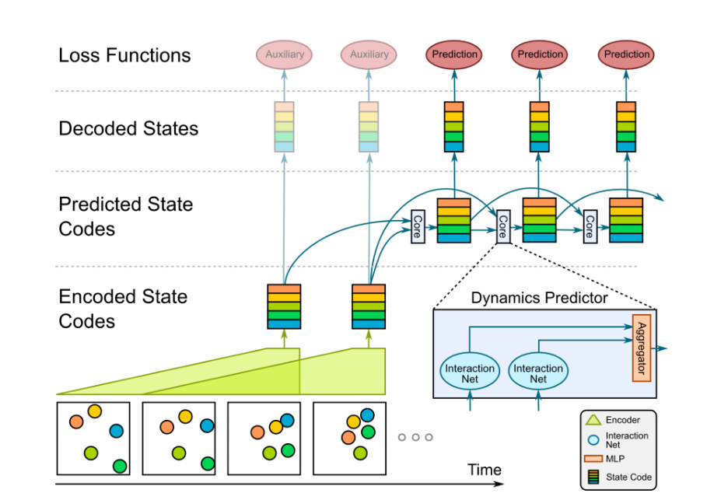

Slide 5
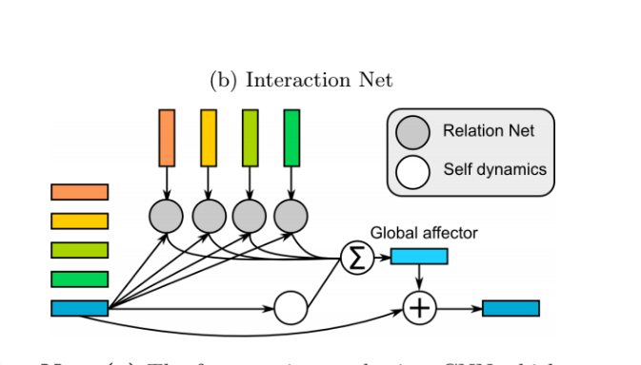

Slide 6
Approach we are taking
We are first working with round objects only.

Slide 7
Two subproblems
EXTRACT THE POSITION AND OTHER PHYSICAL INFORMATION OF THE VIDEO FRAME.
USE THESE EXTRACTED FEATURES TO GROUP THE OBJECTS.

Slide 8
First try(working with second subproblem first)
Collect train on position data only.

Slide 9
Data Collection
Use Pybox2D library.
Assume we have 4 Balls.
Collected 300 clips for 30sec each.
Recorded the positions balls as numpy array.
Randomly assigned initial position, the type of interaction(i.e. K/r**2 , or K*r type) , and also random constant K , and radius.
The numpy array’3 first three rows contain these info.
Sampling rate was 60 frames per sec.

Slide 10
Model Architecture Components
BELIEF VECTOR - > A certain dimensional vector containing information on interaction of single balls/ and pairs of balls. (BV1, BV2, BV3, BV4, BV12, BV13, BV14, BV23, BV24, BV34).
SP(self predictor) : A neural net which intakes the belief vector of a ball and its current position, and tries to output the acceleration of the ball. Properties it may have include inertia, mass, environmental damping, etc.
PP (Pair predictor): A neural network which takes Belief vector of a pair of balls and their current positions and ouputs the acceleration of these balls.

Slide 11
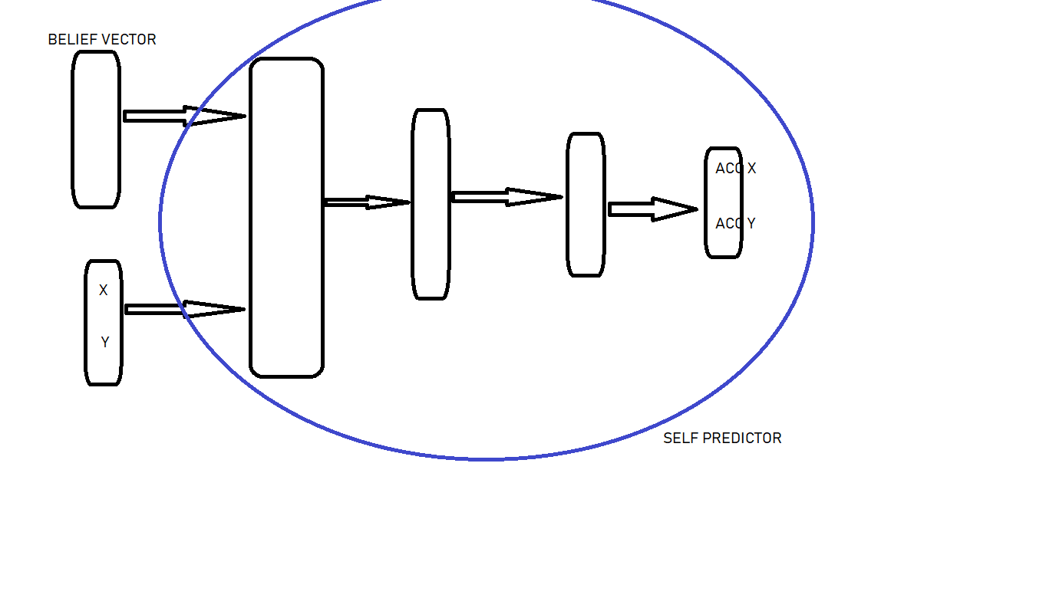

Slide 12
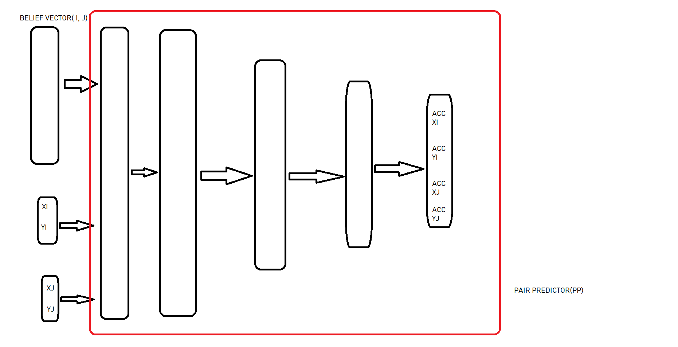

Slide 13
Integration
We use the components described previously to make a model which would intake all belief vectors and positions of four balls and output the acceleration of the balls.

Slide 14
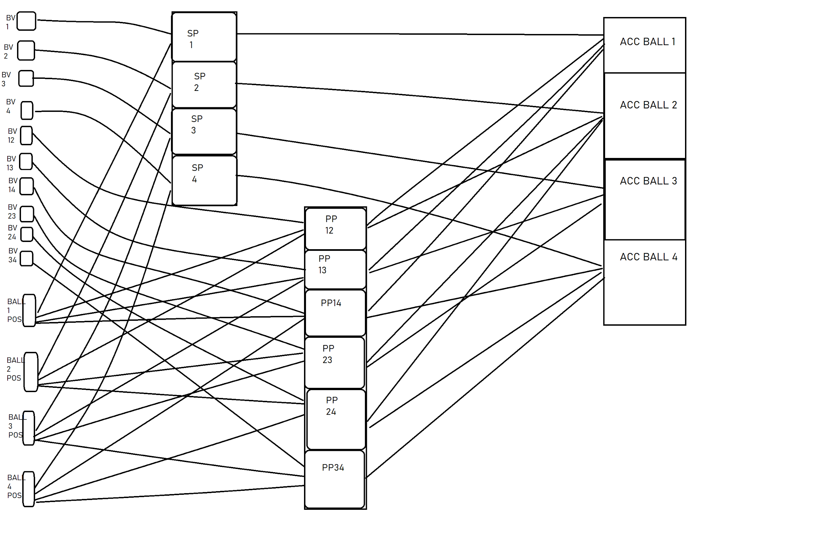
Notes:
Reinforcement learning.
HMM
PGNN
Time series based
RNN’s
Novel

Slide 15
TRAINING AND RESULTS TILL NOW

Slide 16
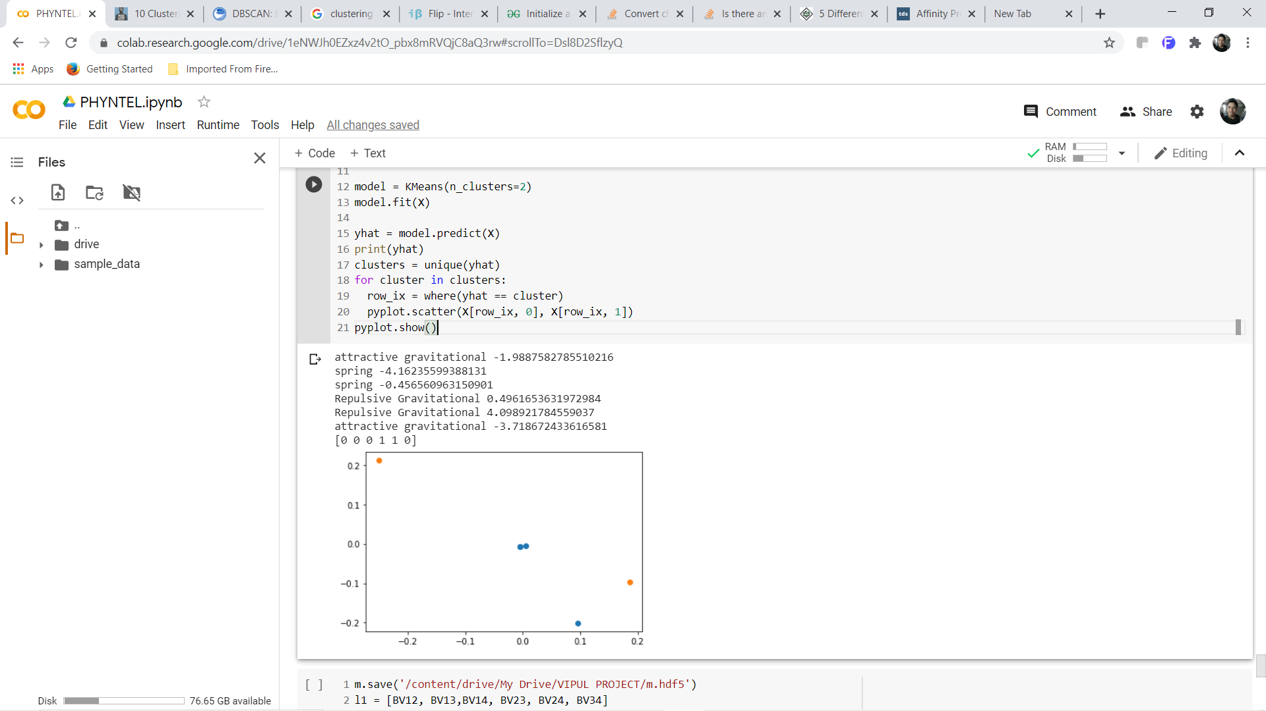
K-means (2 clusters)

Slide 17
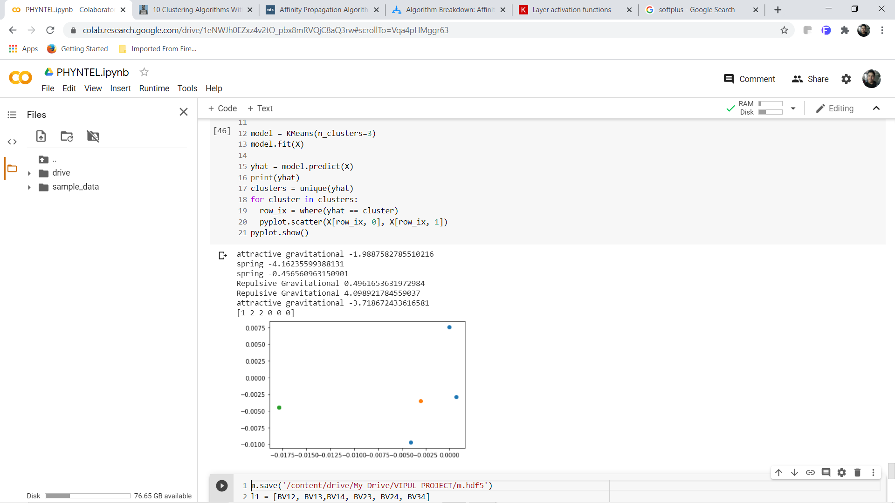
K-means (3 clusters)

Slide 18

K-means (4 clusters)

Slide 19
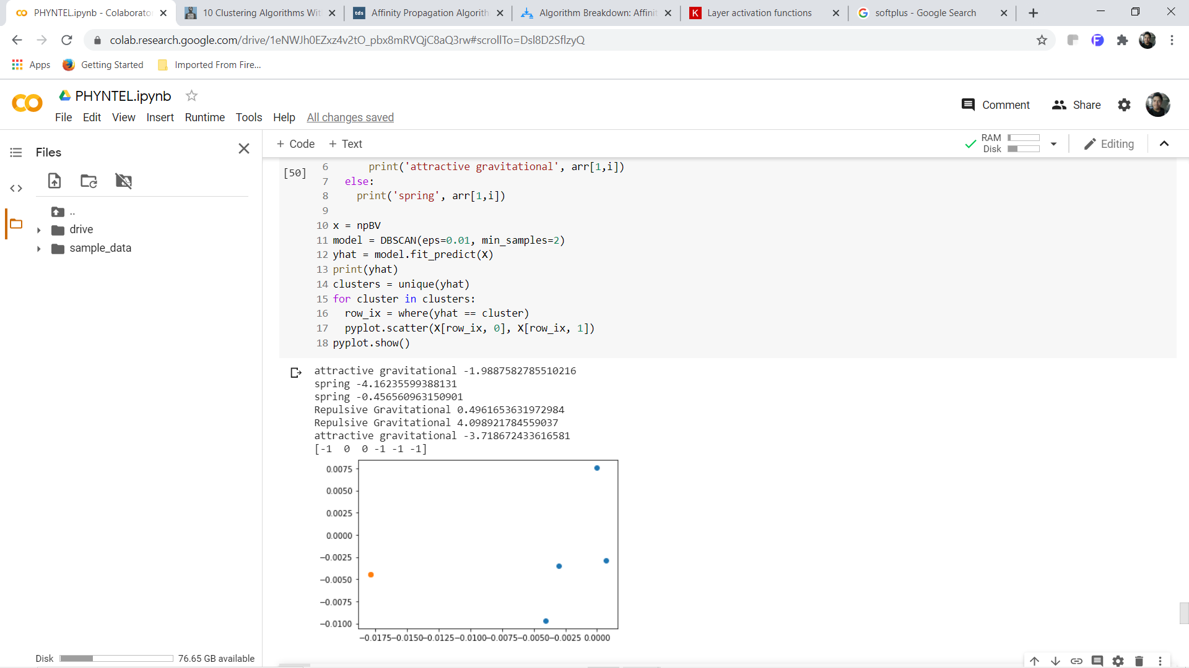
DBSCAN (eps=0.01)

Slide 20
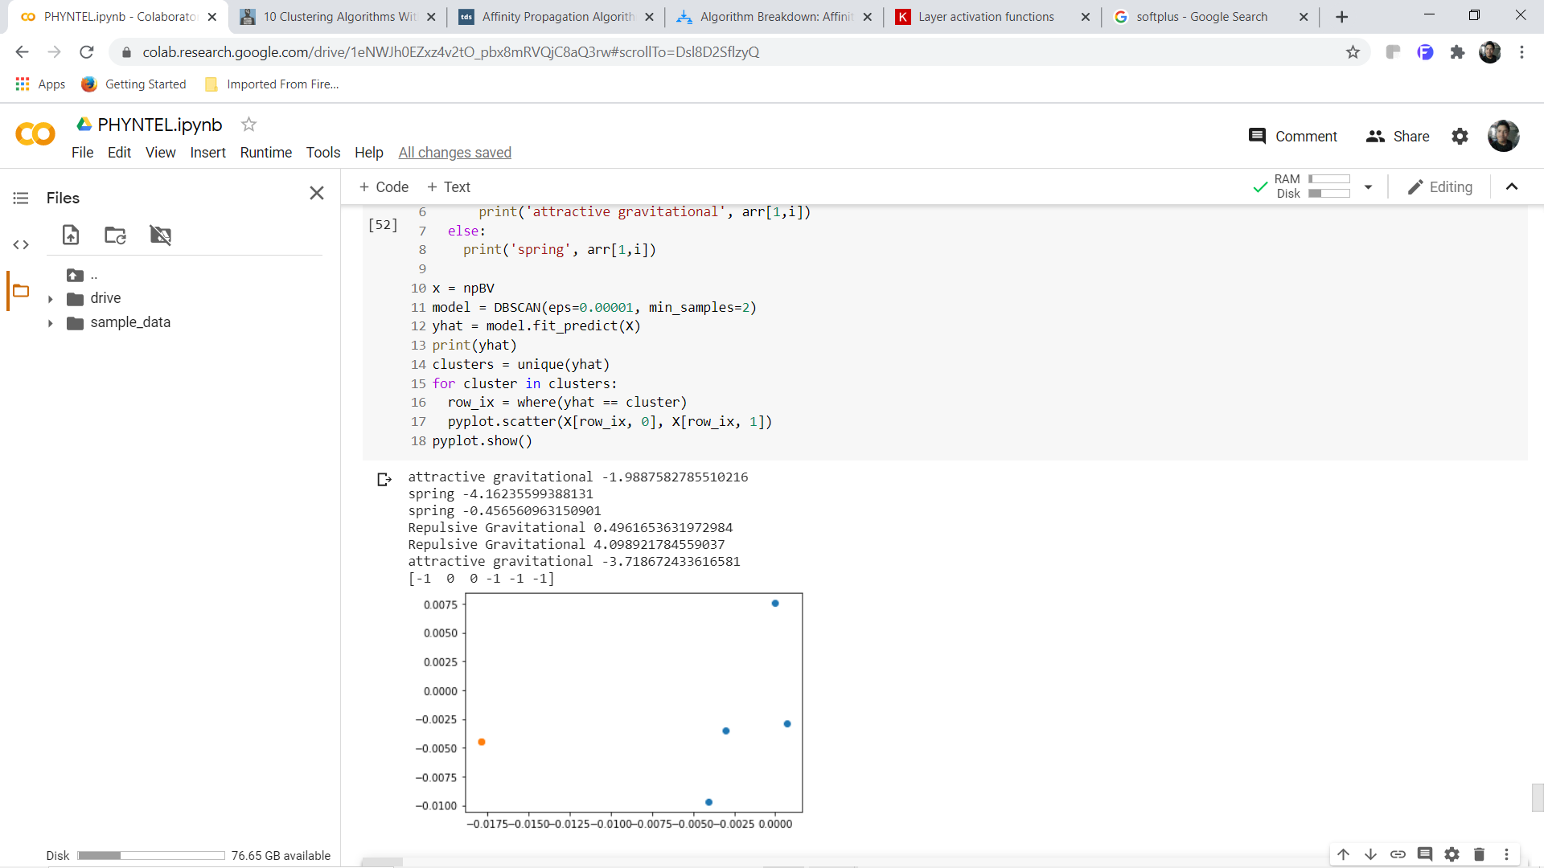
DBSCAN (eps=0.00001)

Slide 21
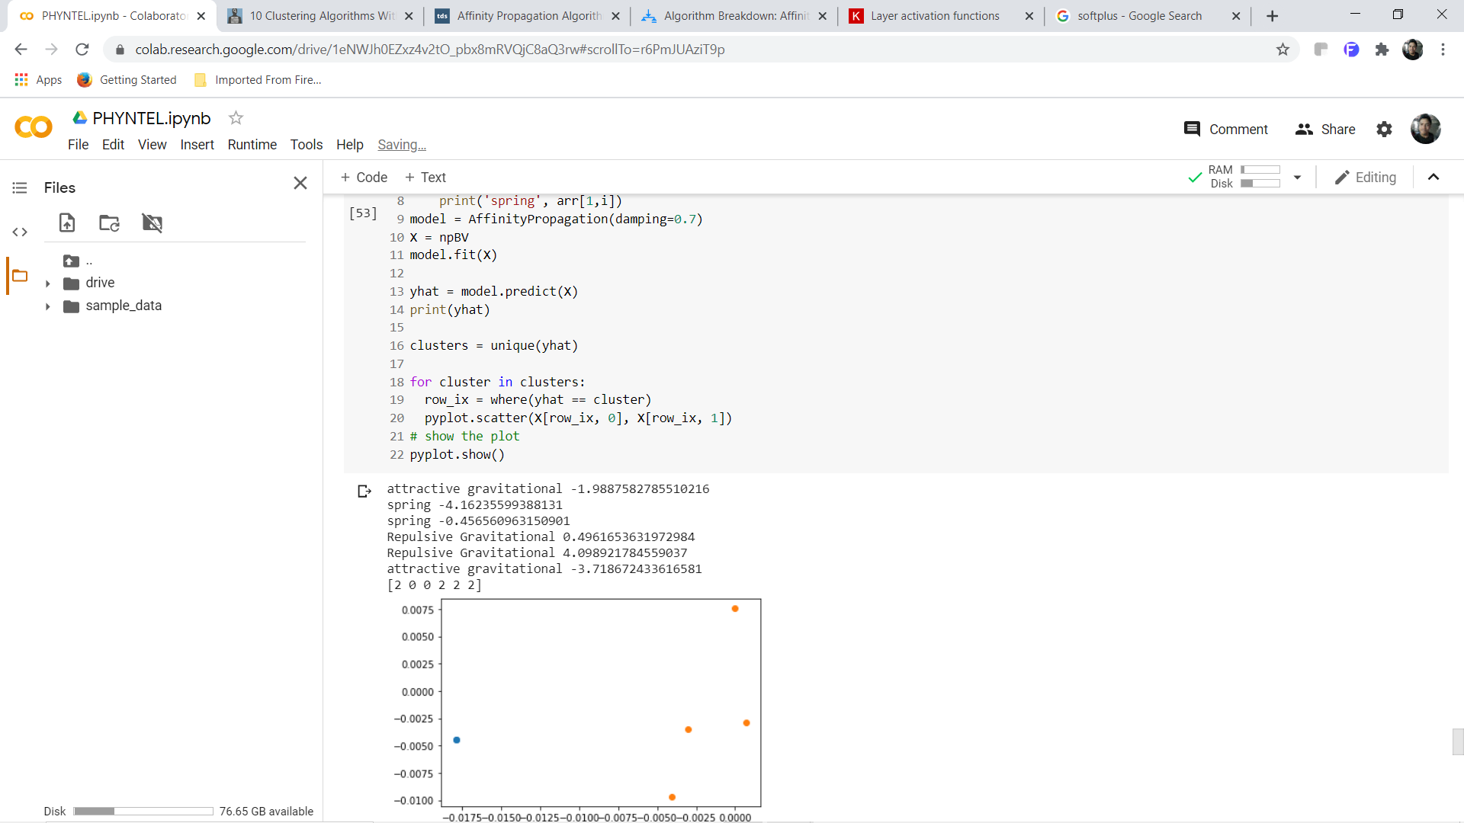
Affinity Propagation(damping = 0.7)

Slide 22
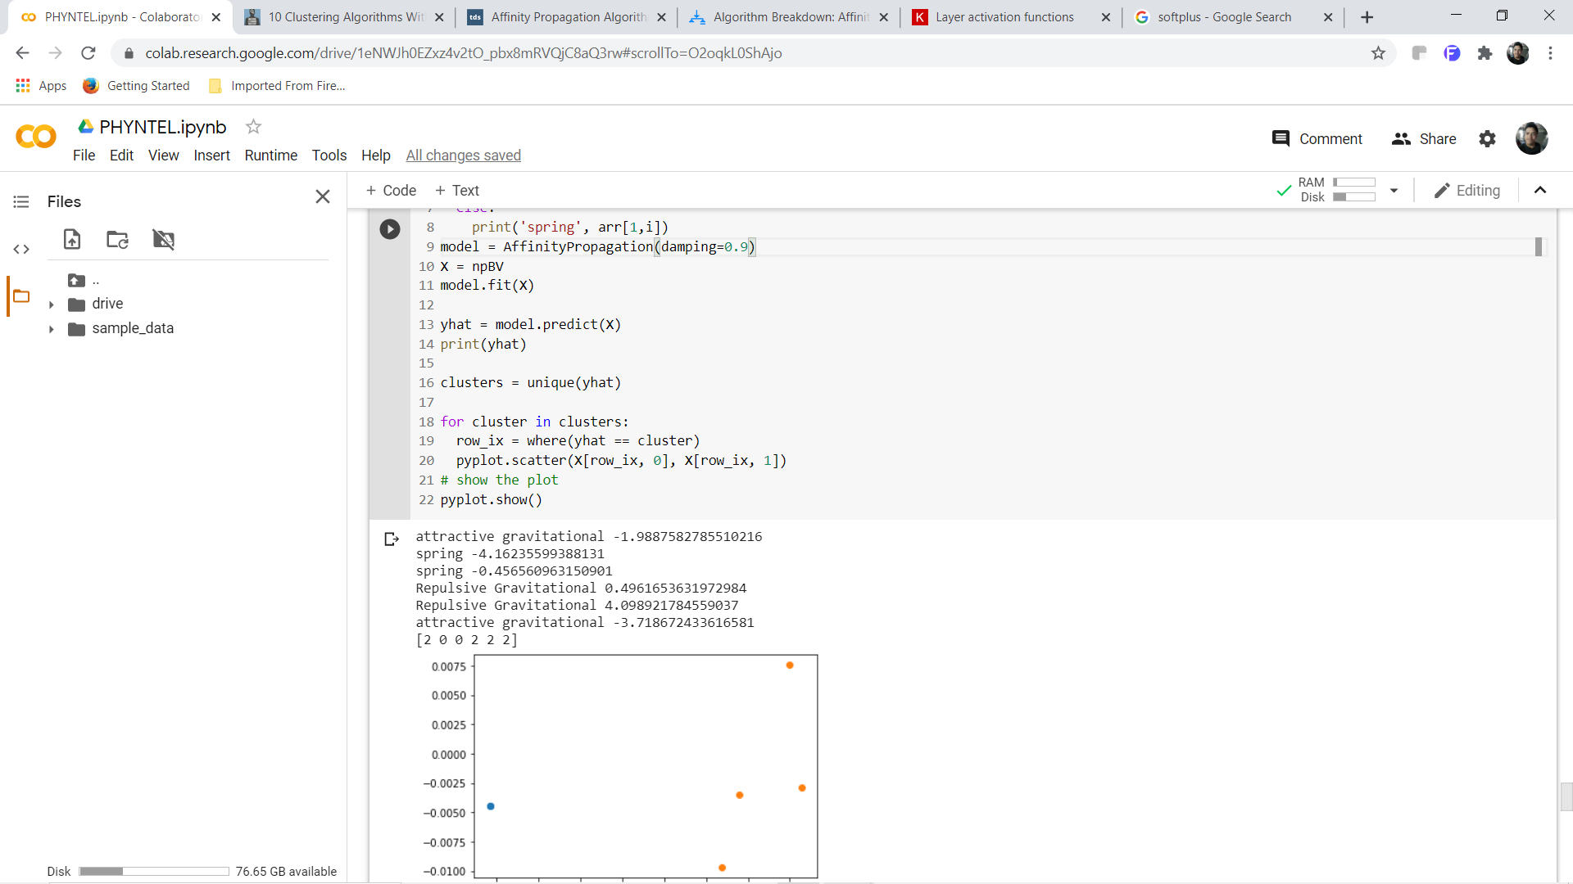
Affinity Propagation(damping = 0.9)

Slide 23
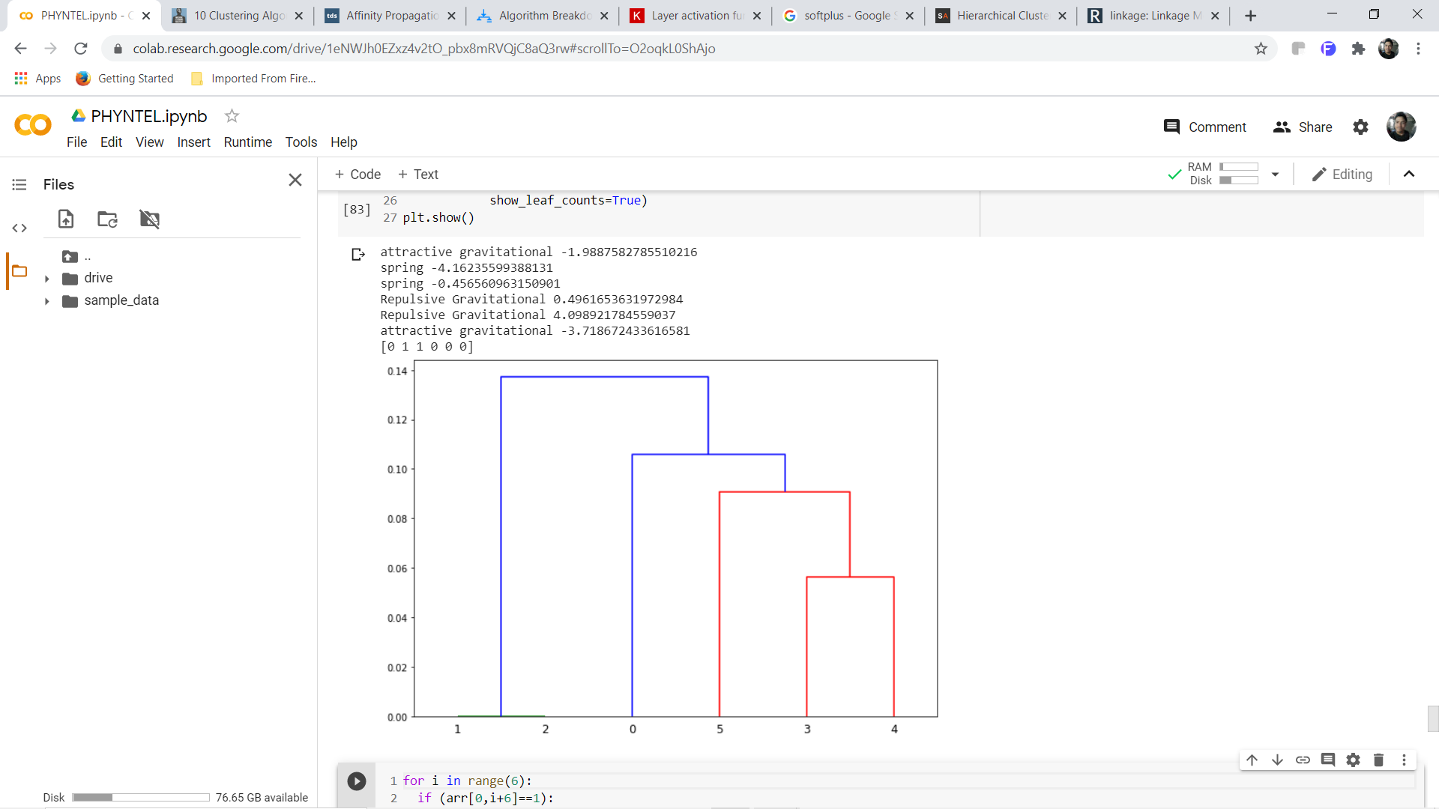
Heirarchial Clustring

Slide 24
Future Approach
Improve Architecture of PP or SP.
Try with more number of balls.

Slide 25
THANK YOU

Slide 26
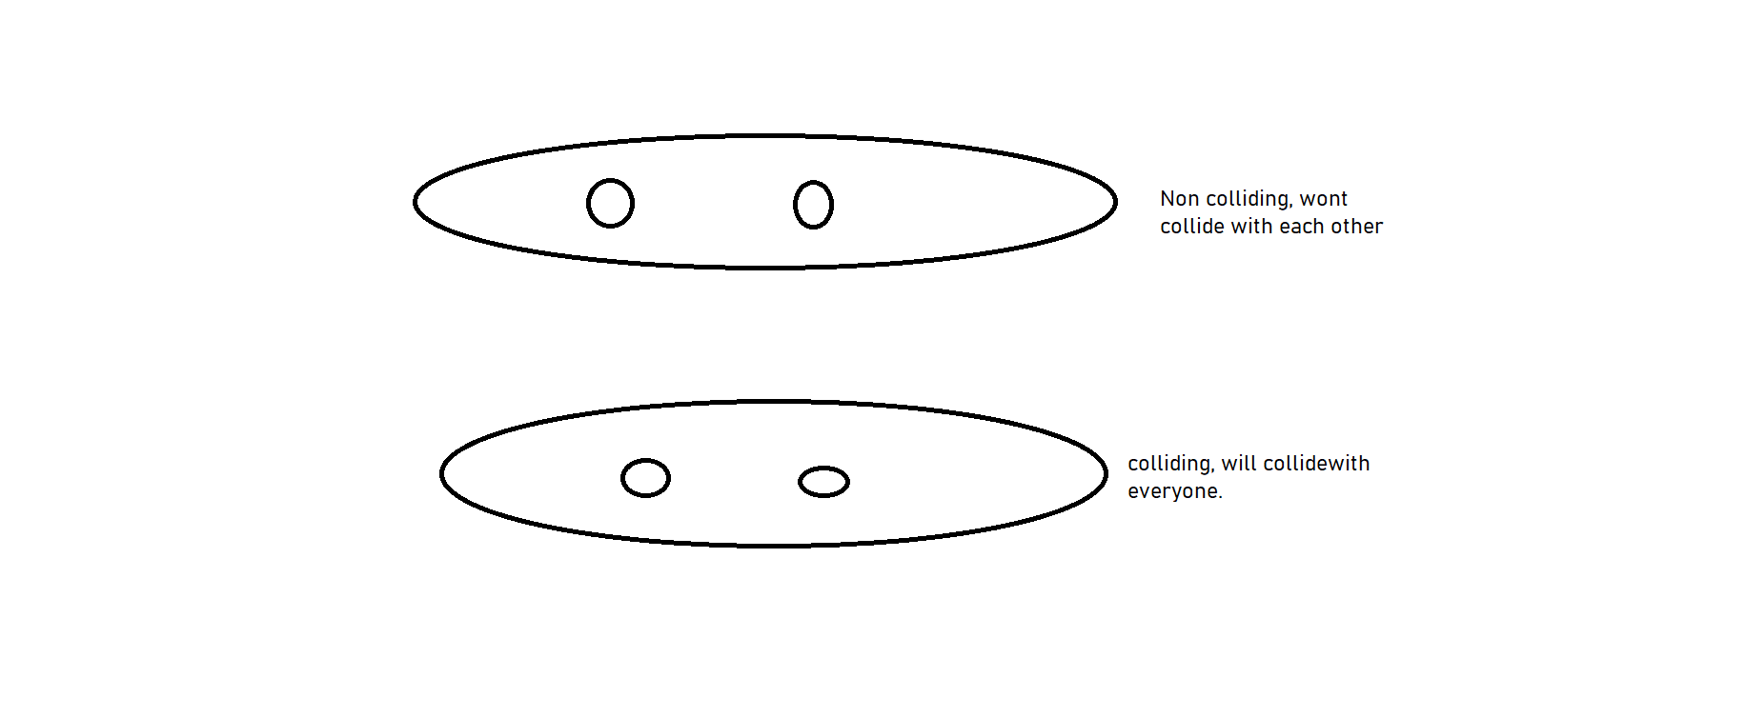
New Data Collection
Collected data for 4 balls with a particular number of balls pass through each other, while rest collide with all the balls. https://iitk-my.sharepoint.com/personal/vermahi_iitk_ac_in/Documents/Microsoft%20Teams%20Chat%20Files/20200702_180326.mp4

Slide 27
Previous Model
Trained the previous architecture on new data, The results were not good, the model did not separate the colliding and non colliding.

Slide 28
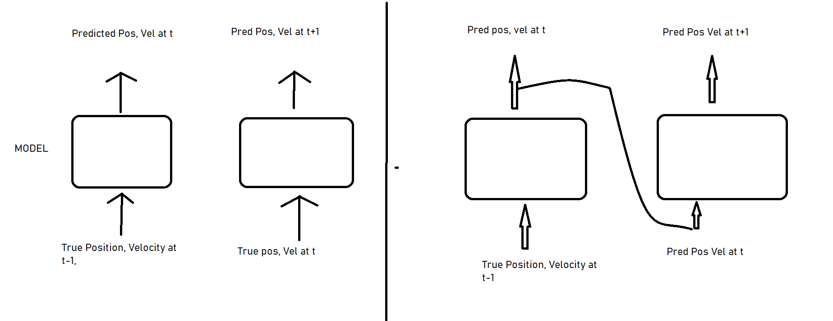
Improvements
Training style:

Slide 29
Results till now(After 400 iterations)
https://colab.research.google.com/drive/1eNWJh0EZxz4v2tO_pbx8mRVQjC8aQ3rw?usp=sharing

Slide 30
Further Plans
https://docs.google.com/spreadsheets/d/1XpFIEYzi-PT6SeneQsliKZ3fO1WCxsBL3Dd_hn3sURg/edit?usp=sharing

Slide 31
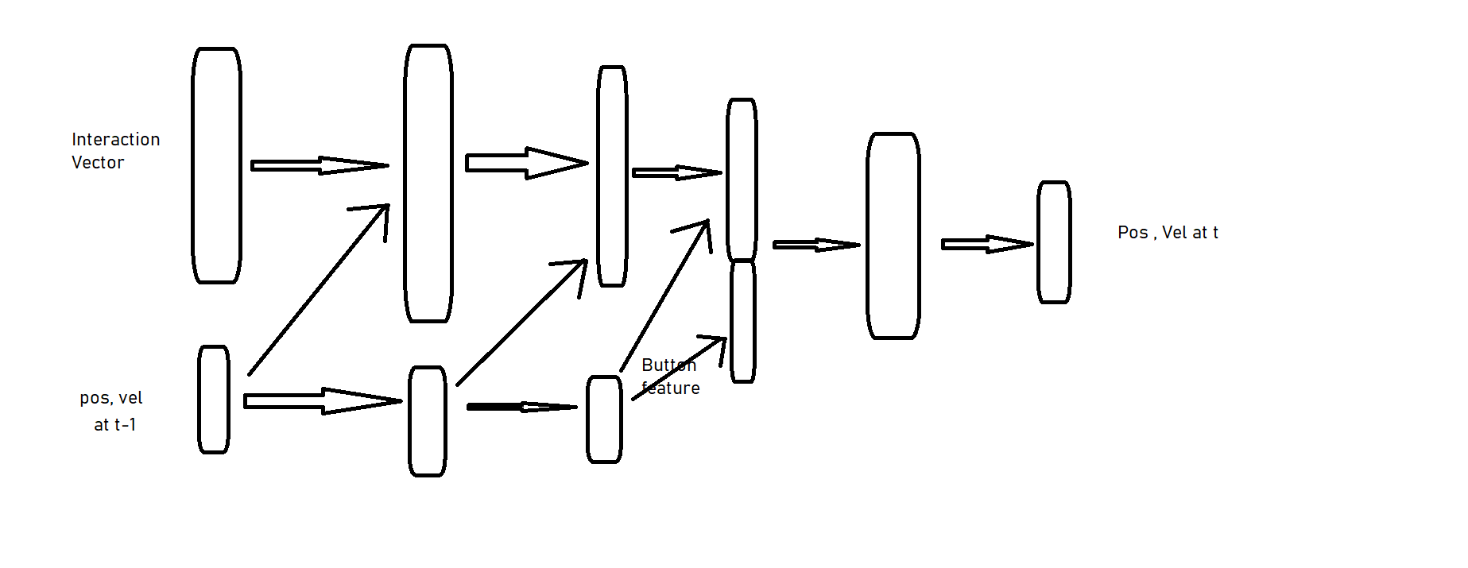

Slide 32
Continued...

Slide 33
2-D

Slide 34
Data Collection
Let the balls be 1,2,3,4 , then the ball 6 ball pairs are -
(1-2) (1,3) (1,4) (2,3) (2,4) (3,4)
No no no yes yes yes
For 1-D data, simulate 4 balls with one ball invisible and other three solid balls.
For 2-D data, simulate 4 balls with one ball invisible and other three solid balls. With only collision as the interaction.

Slide 35
Working models
Two architectures worked.
First one totally unsupervised
Second one semi-supervised(requires a person to know the property vaector of different ball pairs), but fulfills the purpose.

Slide 36
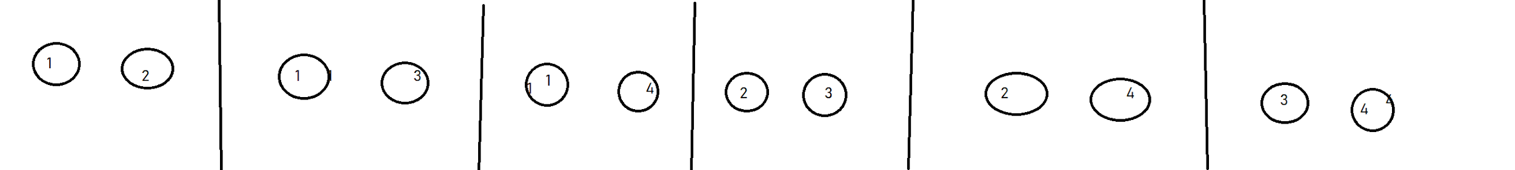
Data Preparation
Extract the trajectory around different instances of isolated interactions of ball pairs
Record the time series of Position
Photo

Slide 37
First model

Slide 38
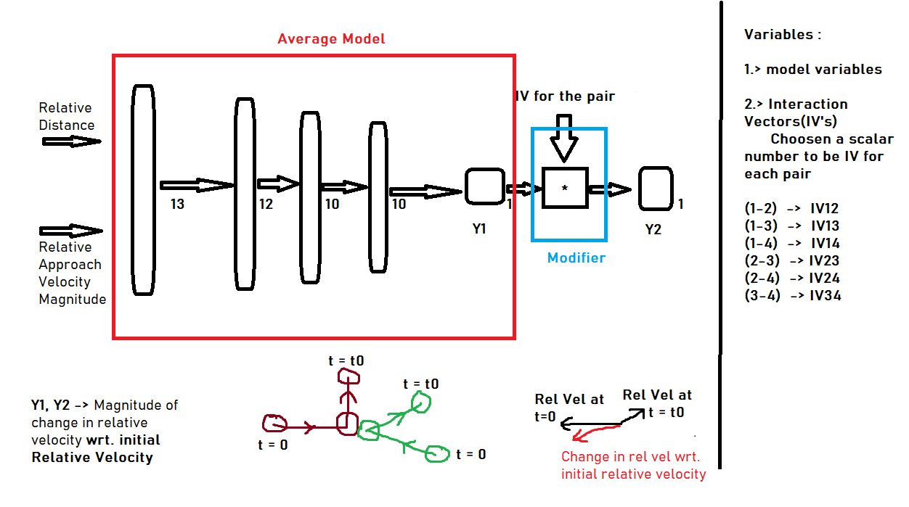
PHOTO

Slide 39
Training
Features
MSE Loss
Sigmoid activation
Two step training -
Train the Average Model only.
Train the Modifier(Interaction vectors) only.

Slide 40
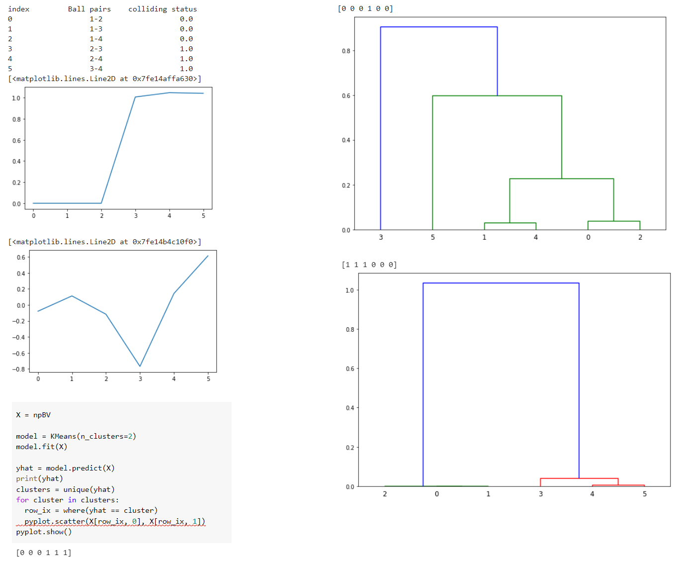

Slide 41
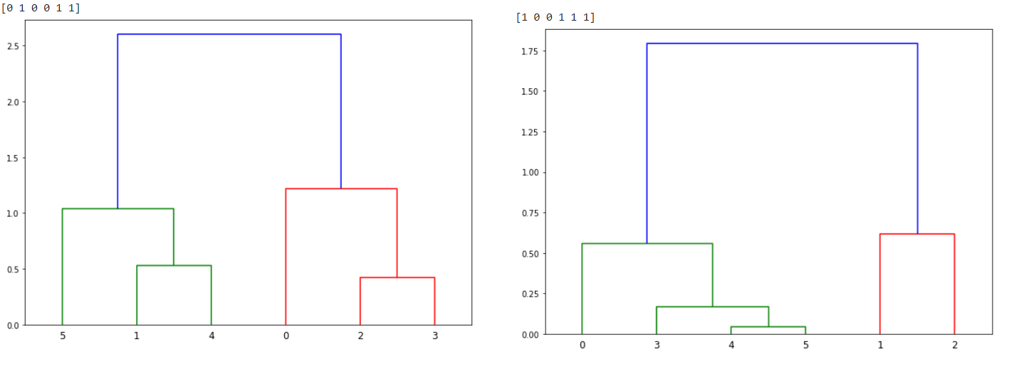

Slide 42
Second Model

Slide 43
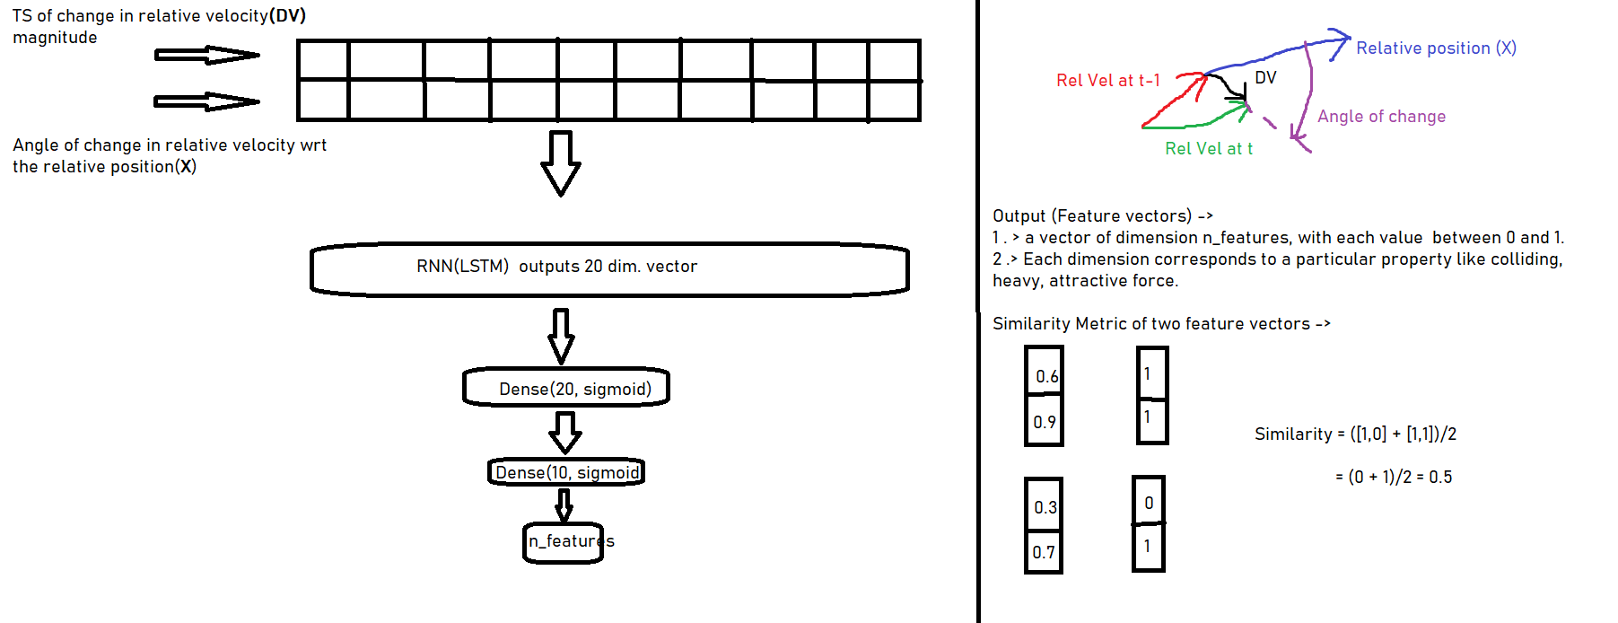

Slide 44
Training
Features -
KL Divergence Loss
Supervised Learning on currently present balls

Slide 45
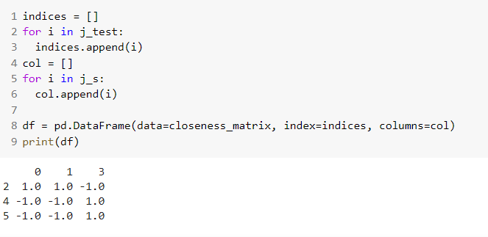
Train and Test
Supervised training with ball 4 missing.
Find the feature vectors of interaction of ball 4 with other balls.
Use similarity metric to construct the similarity matrix of interaction of new ball with previous balls with respect to the interaction of old ball pairs
Here, trained on 0 = (1-2), 1 = (1-3), 3 = (2-3) ball pairs
Tested on introduction of ball 4 i.e. 2 = (1-4), 4 = (2,4), 5 = (3-4)
Ball 1 is invisible hence (0,1,2) are non-colliding and (3,4,5) are colliding.

Slide 46
1-D

Slide 47
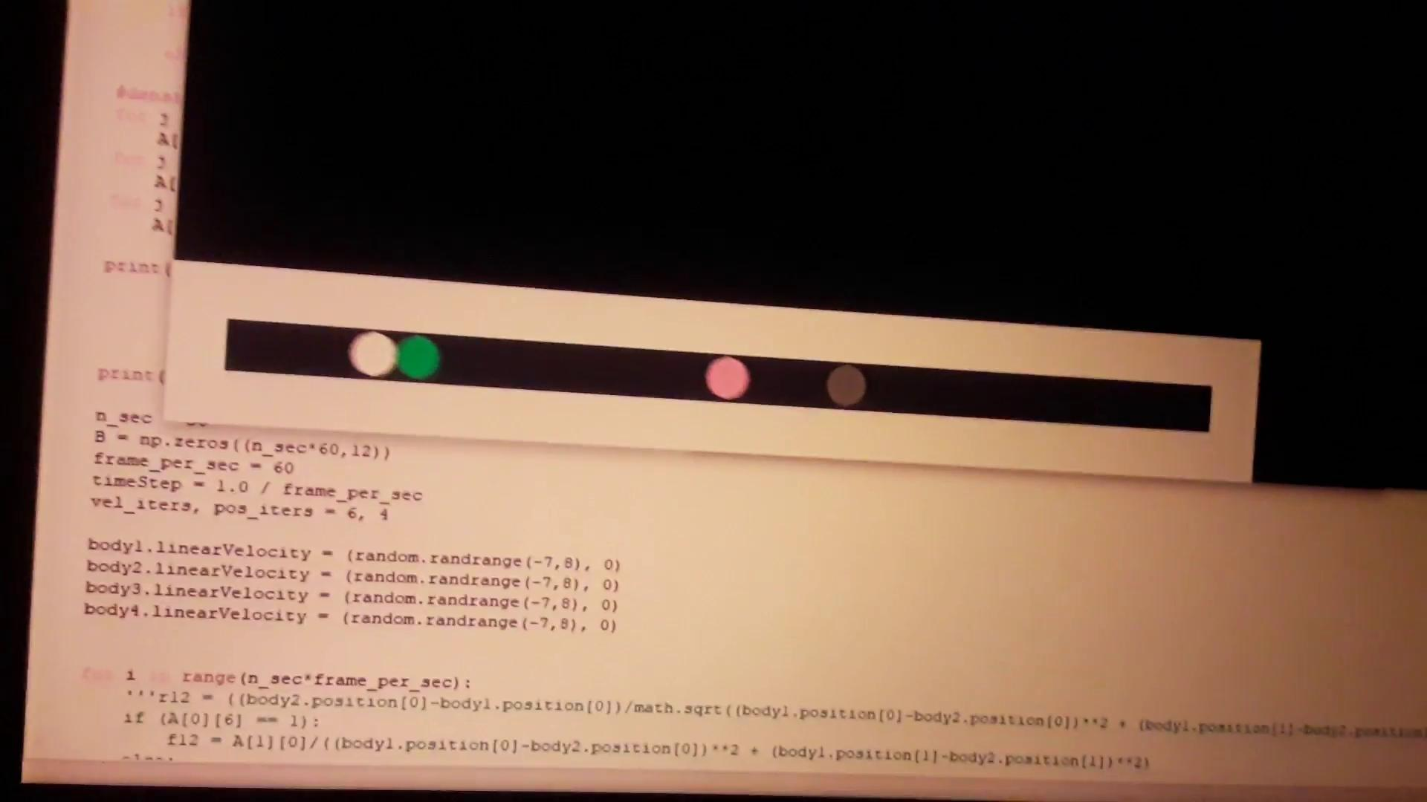

Slide 48
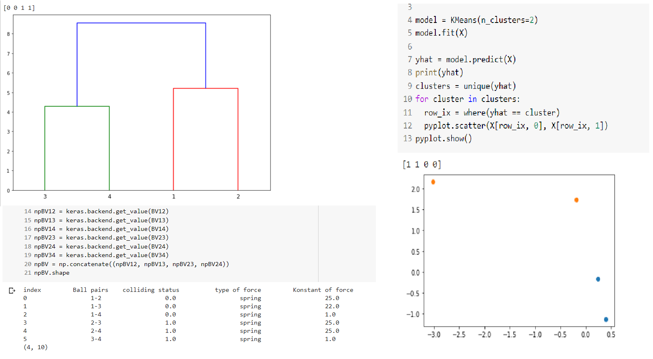

Slide 49
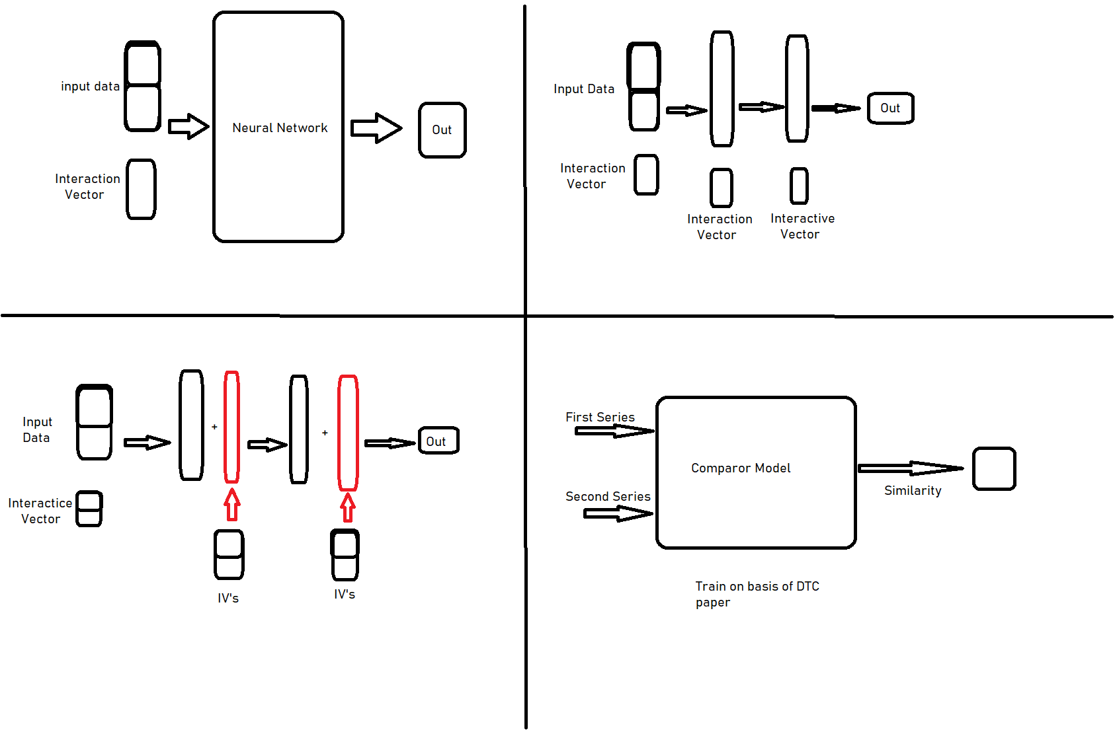
Failures

